Slide 1
Using Bayesian Optimization in Pose Graphs Based SLAM 11th August
Zuxun Wang

Slide 2
Progress Since Last Meeting
Fixing Q Estimate R and fixing R, estimating Q
Compute covariances difference using Frobenius Norm
Test Linear System with modified prediction intervals
For GPS system, compare CNIS values generated by optimal values with that generated using BayesOpt
Investigating Variable Timestep Lengths
One whole graph: Single Timestep vs. Multiple Timesteps
Subgraphs: each with its own prediction interval length

Slide 3
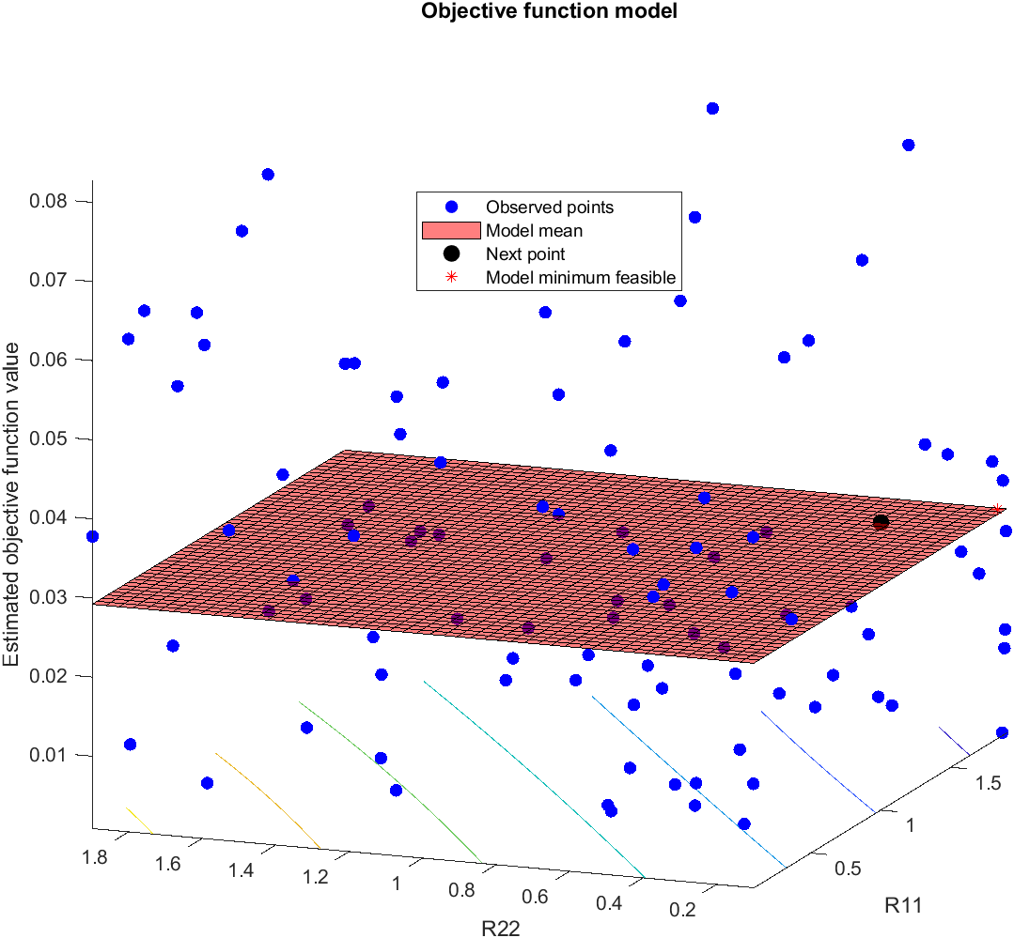
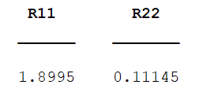
GPS fix Q estimate R
Total number of timestep: 20
Number of episodes: 2000
Evaluation Time: 100
AcqFunc: expected-improvement-plus
FrobeniusNorm: 1.554659674126710
(untuned) FrobeniusNorm: 16.024497257652857

Slide 4
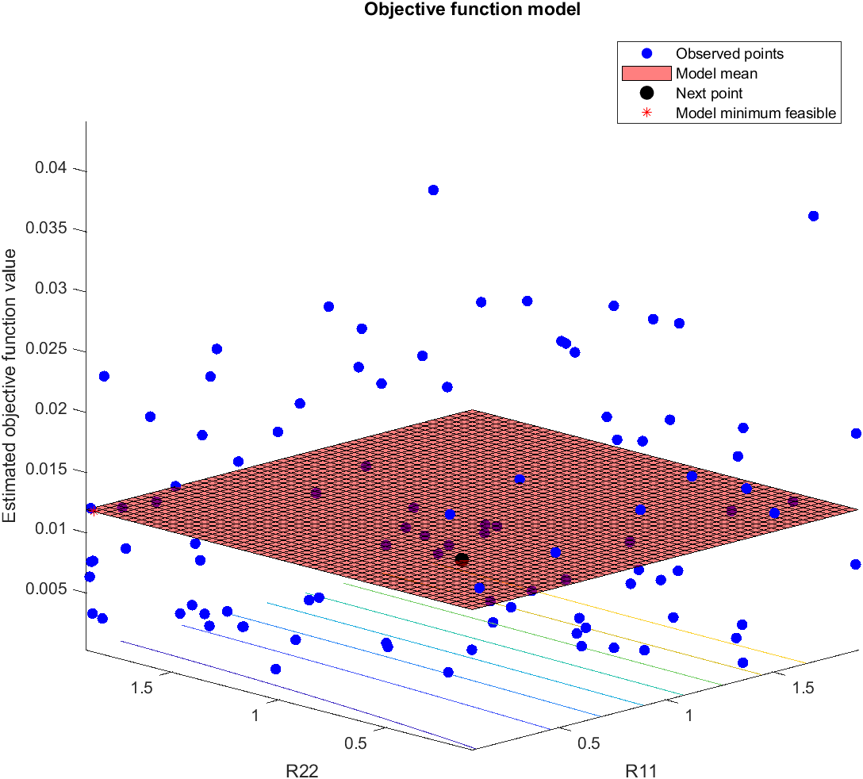
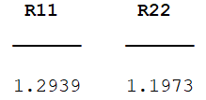
GPS fix Q estimate R
Total number of timestep: 40
Number of episodes: 10000
Evaluation Time: 100
AcqFunc: expected-improvement-plus
FrobeniusNorm: 0.446814073905909z
(untuned) FrobeniusNorm: 17.987094494004193

Slide 5
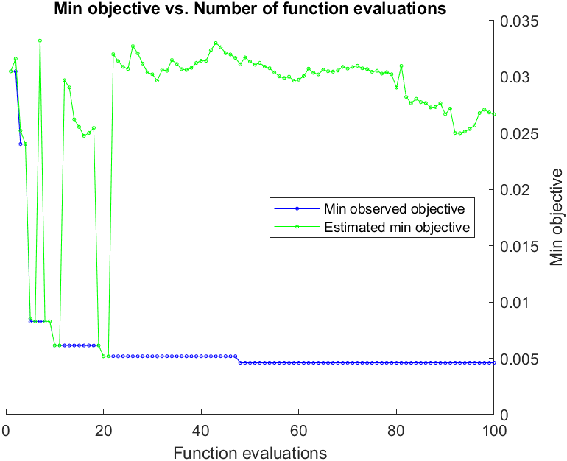
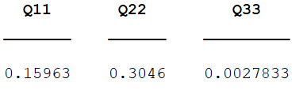
GPS fix R estimate Q
Total number of timestep: 20
Number of episodes: 2000
Evaluation Time: 100
AcqFunc: expected-improvement-plus
FrobeniusNorm:
0.639412626796863
(untuned) FrobeniusNorm: 16.024497257652857

Slide 6
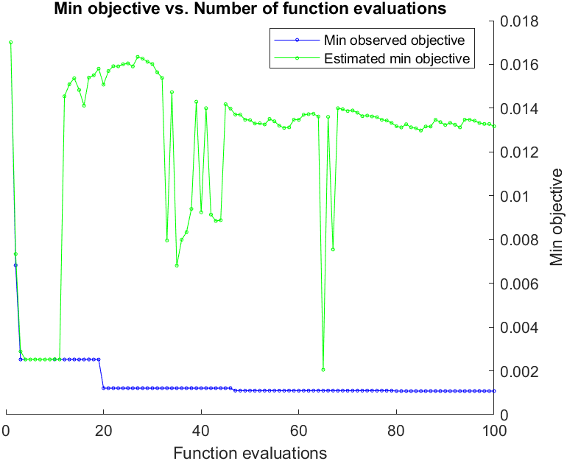
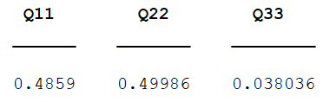
GPS fix R estimate Q
Total number of timestep: 40
Number of episodes: 10000
Evaluation Time: 100
AcqFunc: expected-improvement-plus
FrobeniusNorm:
2.324775909317252
(untuned) FrobeniusNorm: 17.987094494004193

Slide 7
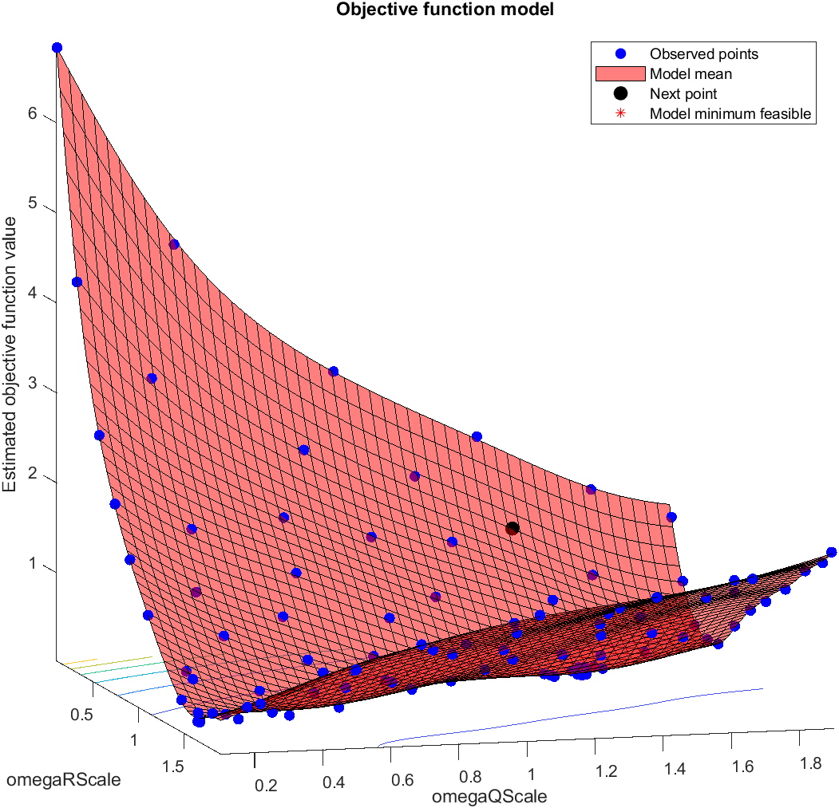
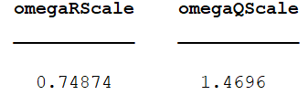
Linear BayesOpt Results (Prop4)
Total number of timestep: 200
Number of episodes: 1000
numObs: 50
obsPeriod: 10
AcqFunc: expected-improvement-plus
Min Objective: 0.024201789912358

Slide 8
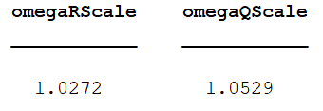
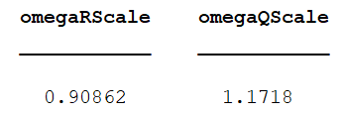
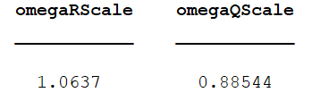
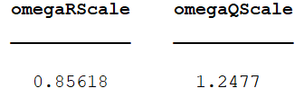
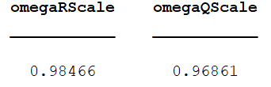
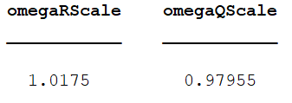
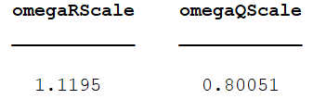
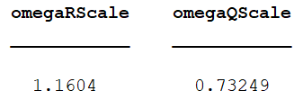
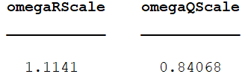
Linear BayesOpt Results (Prop4)
0.197113202893070
0.015117456700423
0.030148699021946
0.072638476109780
0.146339606793521
0.027624674268298
0.075473066256444
0.029795899750483
0.086215017662342
Ground Truth CNIS: 0.044809790343929

Slide 9
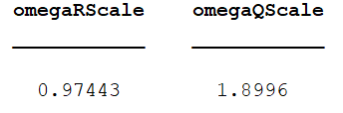
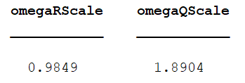
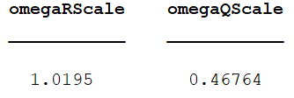
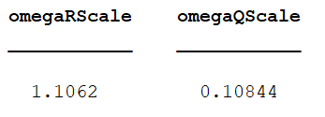
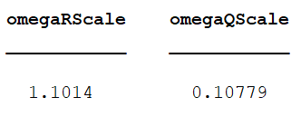
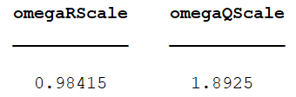
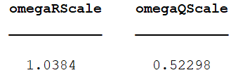
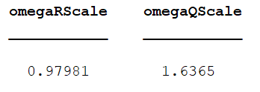
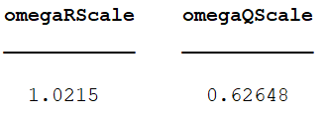
GPS BayesOpt Results (40-10000_Prop4)
0.029174864405922
0.027313411744135
0.018250916767688
0.040158069082621
0.045386651256319
0.025823844706768
0.037441359767072
0.012423848418273
0.053844469134839
Ground Truth CNIS: 0.034879336017828

Slide 10
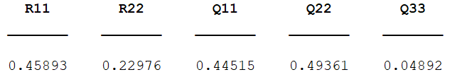
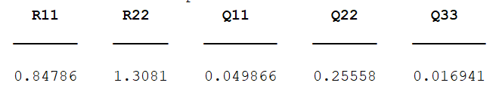
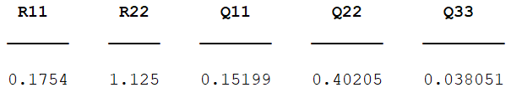
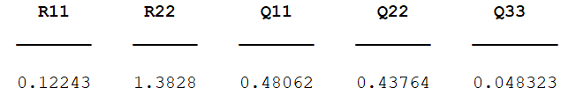
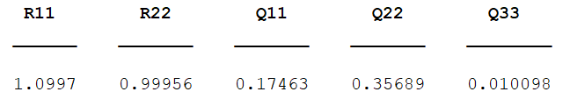
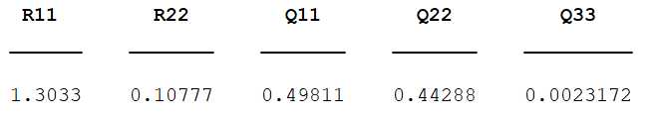
GPS BayesOpt Results (40-10000_Prop4)
0.003734778315781
0.005866006147363
0.019776570217708
0.009175315994310
0.025770692245658
0.021390116572976
Ground Truth CNIS: 0.016718915875288

Slide 11
Investigating Variable Timestep Lengths
Omega Value Pairs
CNIS for Single Timestep
CNIS for Multiple Timesteps
(obsPeriod = 10)
0.062206343153916
0.015117456700423
0.166349435121080
0.029795899750483
0.033094599766985
0.030148699021946
0.044965702300240
0.027624674268298
“Optimal” values
0.010225564542767
0.044809790343929

Slide 12
Investigating Variable Timestep Lengths
Omega Value Pairs
CNIS for Single Timestep
CNIS for Multiple Timesteps
(obsPeriod = 10)
0.193263653542272
0.072638476109780
0.208669645002341
0.075473066256444
0.218892379908350
0.086215017662342
Optimal values
0.010225564542767
0.044809790343929

Slide 13
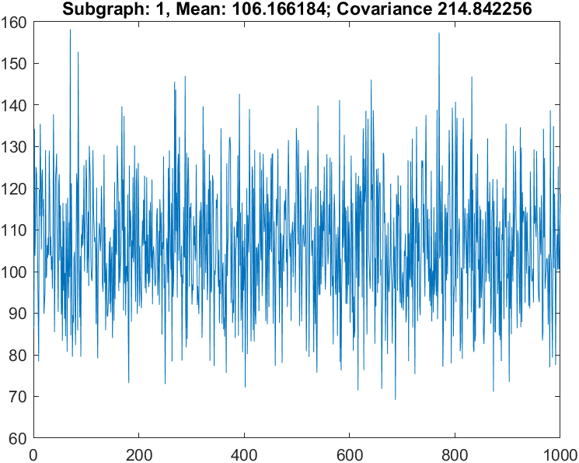
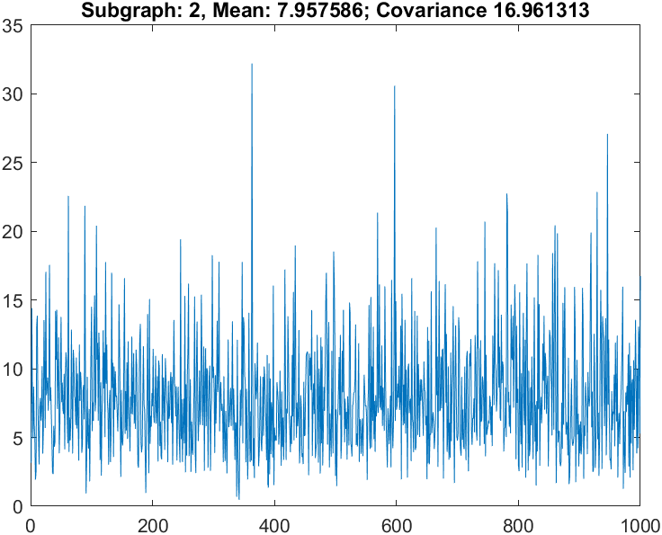
Investigating Variable Timestep Lengths (Subgraphs)
Total number of timestep: 200
Number of episodes: 1000
Num of subgraph: 2
numObs: 50
obsPeriod: [10 20]
Result CNIS Values for each subgraph:
[0.014884336181058, 0.063662098372912]

Slide 14
Problems / Issues

Slide 15
Planned Activities
Bug for multi timestep?
Store the simulated z results
Check the performance of either system
Checking the [X, Px] of the graph
Optimise it and Compare with the optimal graph

